Slide 1
Conducting Research in the College Library

Slide 2
This Presentation Will Show You:
How to get help from the College Librarian
How to identify and find quantitative and qualitative research study articles
How to use the eLibrary and its databases to find articles
How to get full-text articles on your own or request them from the librarian
Tips on finding articles you can use
And more!

Slide 3
Getting Help
Tina Metzger, College Librarian
Monday through Friday
8:00 a.m. – 4:30 p.m.
Available to Zoom, Email, or Meet in Person
tina_metzger@bshsi.org
library@bsmcon.edu
https://www.bsmcon.edu/library

Slide 4
Before You Begin Your Article Search
“Before learning techniques for searching, one important factor to remember is that although there is an abundance of evidence and research about many topics, there is a chance that there might not be a study that answers your question. How will you know? If you do not locate any evidence related to your topic after conducting a sound search in at least a few databases using terminology that encompasses your topic well, this is a sign that perhaps your question has not been directly answered.”
Schmidt, N. & Brown, J. (2022). Evidence –Based Practice for Nurses: Appraisal and Application of Research. Jones & Bartlett Learning (p. 127)

Slide 5
“One Perfect Source?”
https://www.lib.ncsu.edu/videos/one-perfect-source
North Carolina State University Libraries

Slide 6
Books in the Library

Slide 7
Quantitative Research: “Using numbers to provide evidence” (Schmidt & Brown) Qualitative Research: “Used to answer questions related to the hows and whys of behavior that are not easily explained through quantitative methods” (Schmidt & Brown)

Slide 8
Qualitative vs. Quantitative Research: Overview
Learn to distinguish between qualitative and quantitative research.
Qualitative and Quantitative Research
In general, quantitative research seeks to understand the causal or correlational relationship between variables through testing hypotheses, whereas qualitative research seeks to understand a phenomenon within a real-world context through the use of interviews and observation. Both types of research are valid, and certain research topics are better suited to one approach or the other. However, it is important to understand the differences between qualitative and quantitative research so that you will be able to conduct an informed critique and analysis of any articles that you read, because you will understand the different advantages, disadvantages, and influencing factors for each approach.
The table below illustrates the main differences between qualitative and quantitative research. Be aware that these are generalizations, and that not every research study or article will fit neatly into these categories.
Systematic reviews, meta-analyses, and integrative reviews are not exactly designs, but they synthesize, analyze, and compare the results from many research studies and are somewhat quantitative in nature. However, they are not truly quantitative or qualitative studies.
From Stevenson University Library
 | Qualitative | Quantitative
Keywords | Complexity, contextual, inductive logic, discovery, exploration | Experiment, random assignment, independent/dependent variable, causal/correlational, validity, deductive logic
Purpose | Understand a phenomenon | Discover causal relationships or describe a phenomenon
Sample | Purposive sample, small | Random sample, large
Data | Focus groups, interviews, field observation | Tests, surveys, questionnaires
Methods/Design | Phenomenological, grounded theory, ethnographic, case study, historical/narrative research, participatory research, clinical research | Experimental, quasi-experimental, descriptive, methodological, exploratory, comparative, correlational, developmental (cross-sectional, longitudinal/prospective/cohort, retrospective/ex post facto/case control)

Slide 9
Check out this article: Focusing on the fundamentals:A simplistic differentiation between qualitative and quantitative research

Slide 10
Quantitative | Qualitative
Descriptive | Phenomenological
Correlational | Grounded theory
Quasi-experimental | Ethnographic
Experimental | Exploratory-descriptive
Randomized Controlled Trial (RCT) | Historical
Case-Control Studies | Interviews
Cohort Studies | Focus groups
Correlational Descriptive | Lived experience
Correlational Predictive

Slide 11
How Do I Know If It’s An Actual Research Study?
Research Articles Typically Have the Following Sections:
Abstract
Introduction
Review of the Literature
Methods
Discussion or Conclusion
References
Quantitative and qualitative research articles will NOT have the word “Review” in their titles (more on reviews later).

Slide 12
from Polit, D. & Beck, C. (2022). Essentials of Nursing Research: Appraising Evidence for Nursing Practice. Wolters Kluwer p. 25

Slide 13
(Polit & Beck, p. 28)

Slide 14
(Polit & Beck, p. 29)

Slide 15
Finding Articles: Use The Right Tools for the Job
Top Databases for Research Articles
Ovid Discovery – accessed using the large search box
PubMed
CINAHL
Academic Search Complete
Emcare
-You must log in to Athens to get search results:
https://login.openathens.net/auth
-Register for Athens if you don’t have a login:
https://register.openathens.net/bshsi.org/register
Contact the librarian for assistance
https://bshsi.ovidds.com/

Slide 16
Search Tips
Try the Advanced Search function in each database to narrow your search. For example, you can change the default Keyword search dropdown to Title, to only find articles that have your search term in their titles.
Stay away from articles that have the word “review” in them. However, you can use these articles to “mine” their reference lists for actual studies. Then, just enter the article title in a database search box to find it.
Examine articles and their reference lists for possible additional search term ideas and keep a list so you can try them.
Articles with numbers in their titles (i.e. ES 142) or “Suppl” in their citations are usually just conference or poster abstracts, not full research articles.
Article titles that have brackets around them are in a foreign language.

Slide 17
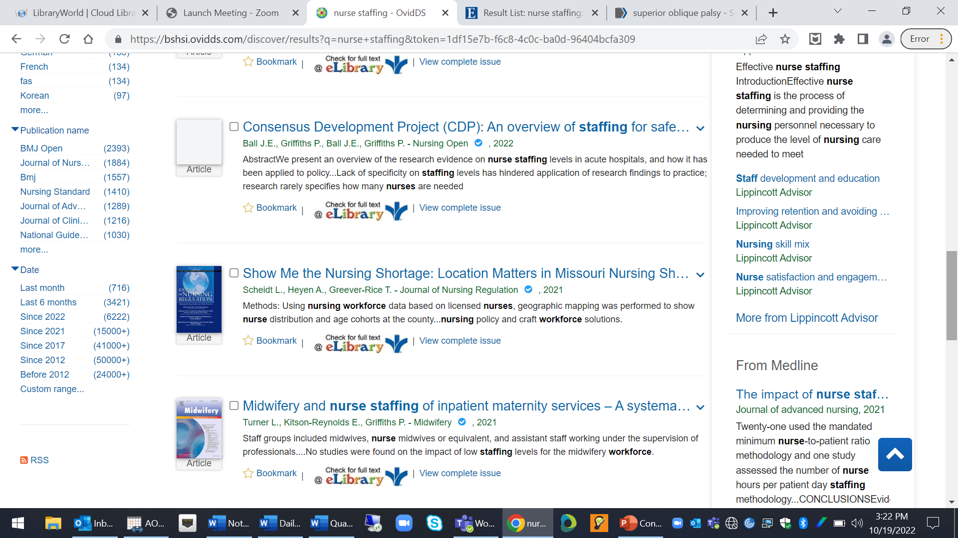
How to Limit Your Ovid Discovery Search Results to Recent Publication Years

Slide 18
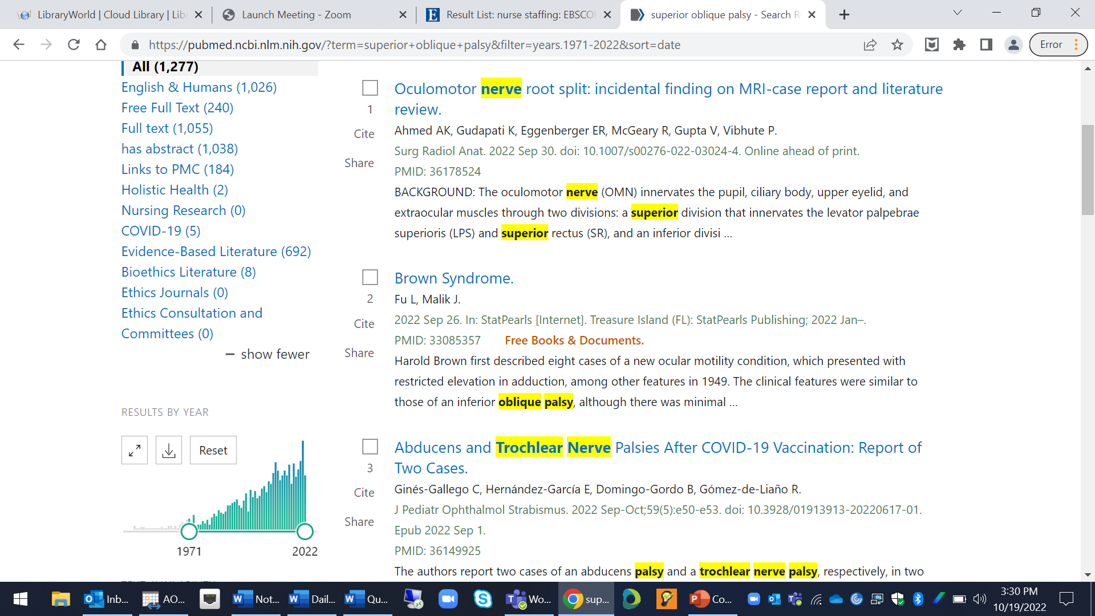
How to Limit Your PubMed Search Results to Recent Publication Years

Slide 19
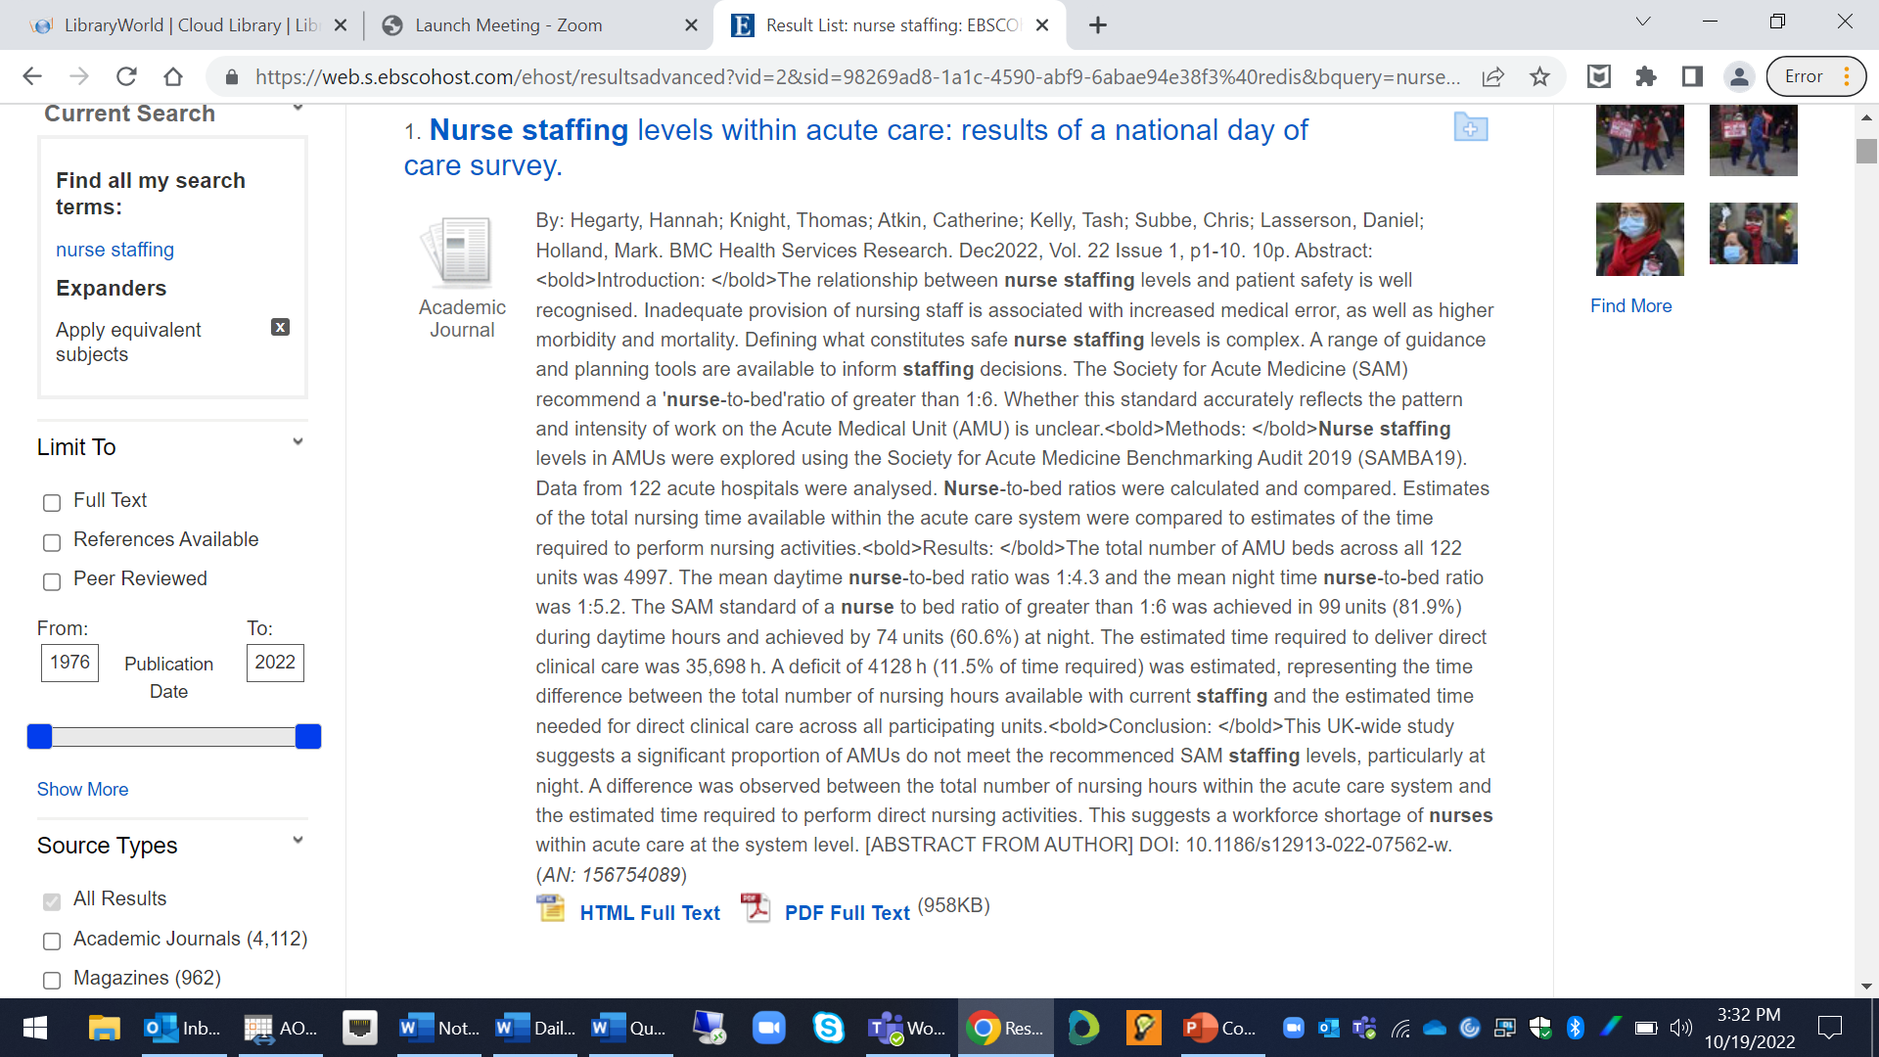
How to Limit Your Academic Search Complete Search Results to Recent Publication Years

Slide 20
Getting Full Text PDFs
Read How to Find Full Text On Your Own
Request full text in Ovid Discovery using the Request Form that appears on the bottom of the screen after clicking on an article title. Be sure to change the Affiliated Location to the College.
Request full text in PubMed by emailing the PMID (number that appears in the article citation) to the librarian.
Request full text in Academic Search Complete by clicking “Check Bon Secours eLibrary for Full Text” after a search results, and either clicking the blue Read Article button or completing the request form.
Request full text from Google Scholar or the Internet by emailing the article title, journal name, volume and issue, or the DOI, to the librarian.

Slide 21
Some Parting Words
Research takes time. You may end up crying real tears if you wait until one or two days before the assignment due date to search for articles. Your instructor may reject some articles you find, so build extra time into your searching.
If you hit a paywall while trying to get full text, contact the librarian. There is no need to ever pay for articles. Most can be obtained by her, using logins and external resources.
Remember that the librarian’s work hours end at 4:30 p.m. Any full text requests or requests for research help made after that time will be filled the following business day.
Ask for help! Finding appropriate articles can be difficult.
Don’t Give Up! Good Luck!

