Slide 1
What You’ll Learn
Doing Library Research – Searching for Articles
What are Scholarly Sources?
What is peer review?
How to find peer-reviewed articles

Slide 2
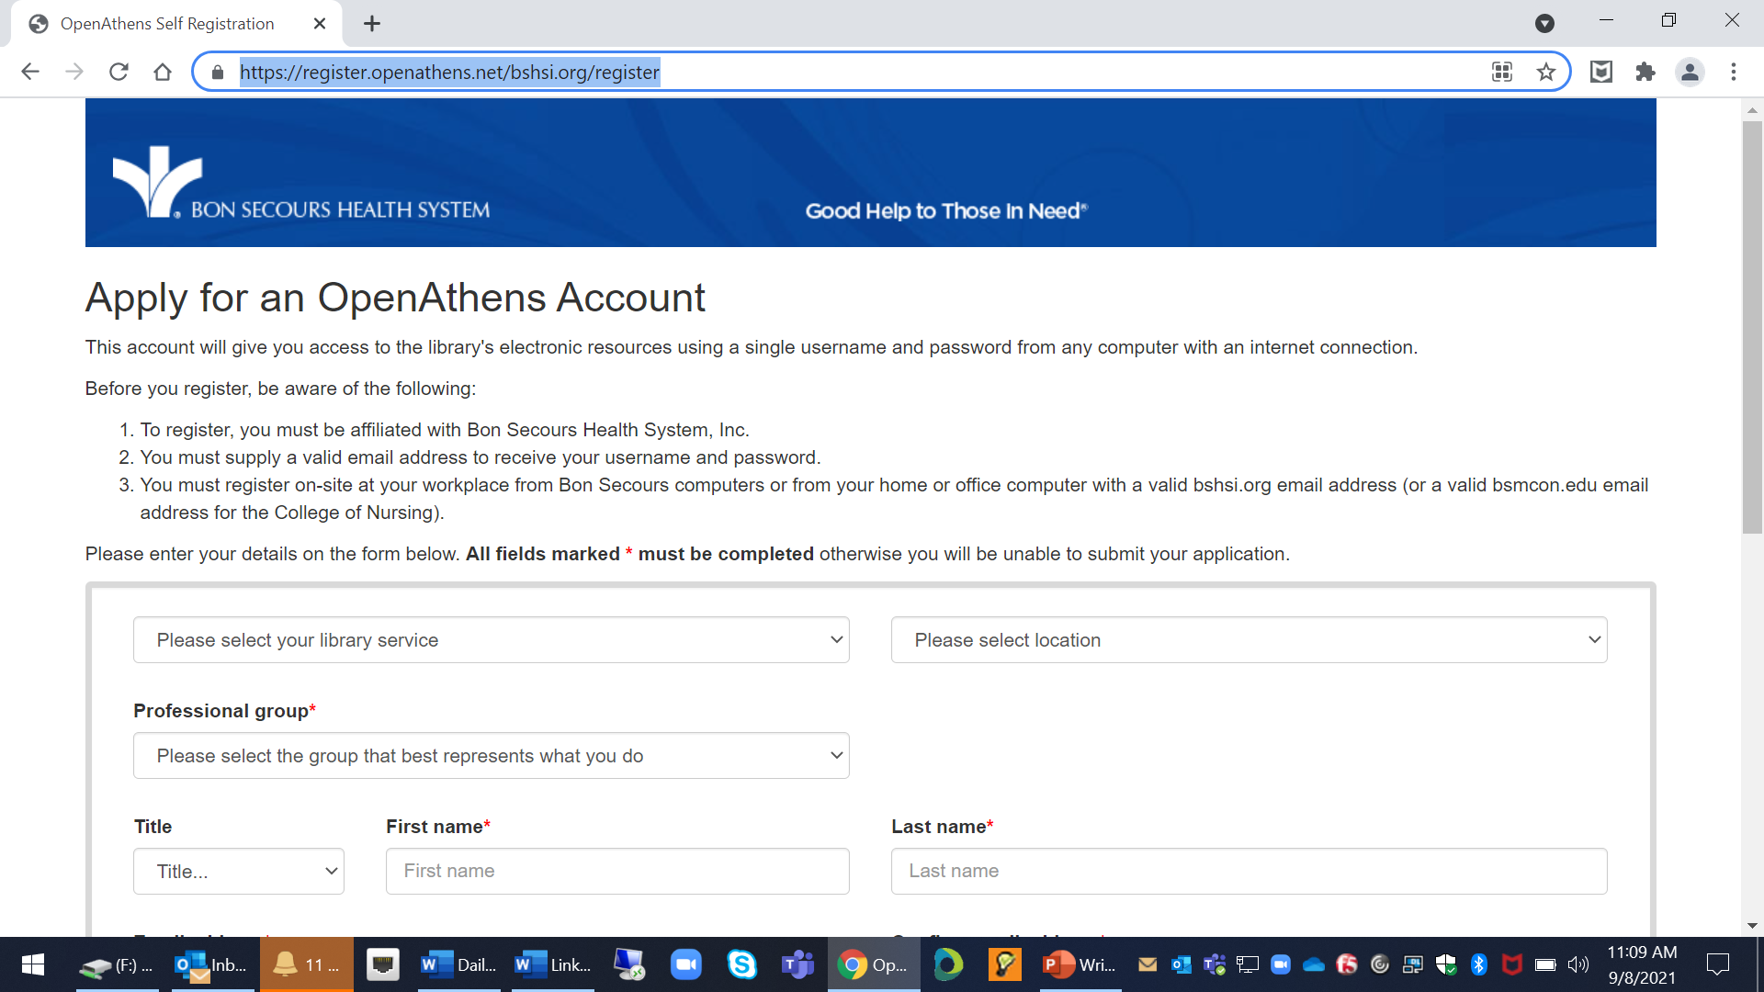
Doing the Research - Start with Athens
https://register.openathens.net/bshsi.org/register

Slide 3
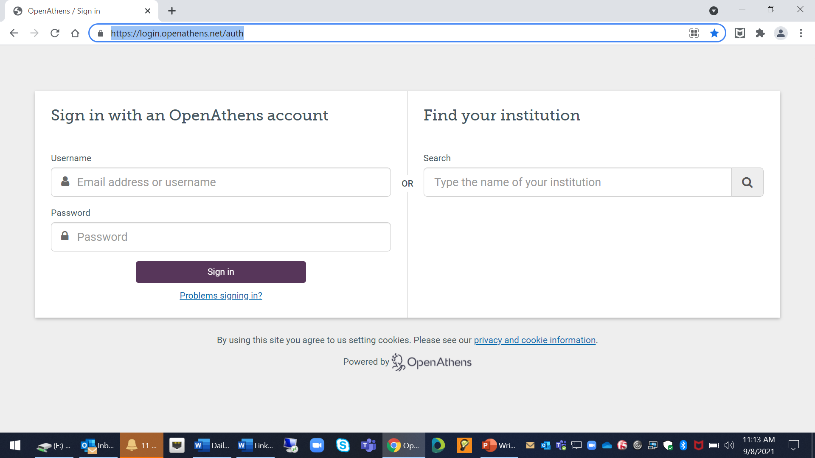
https://login.openathens.net/auth

Slide 4
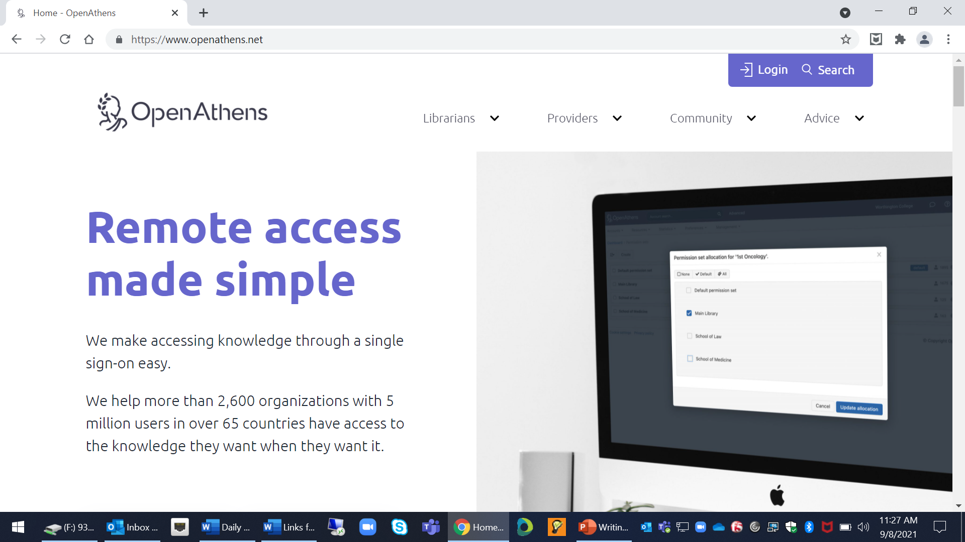

Slide 5
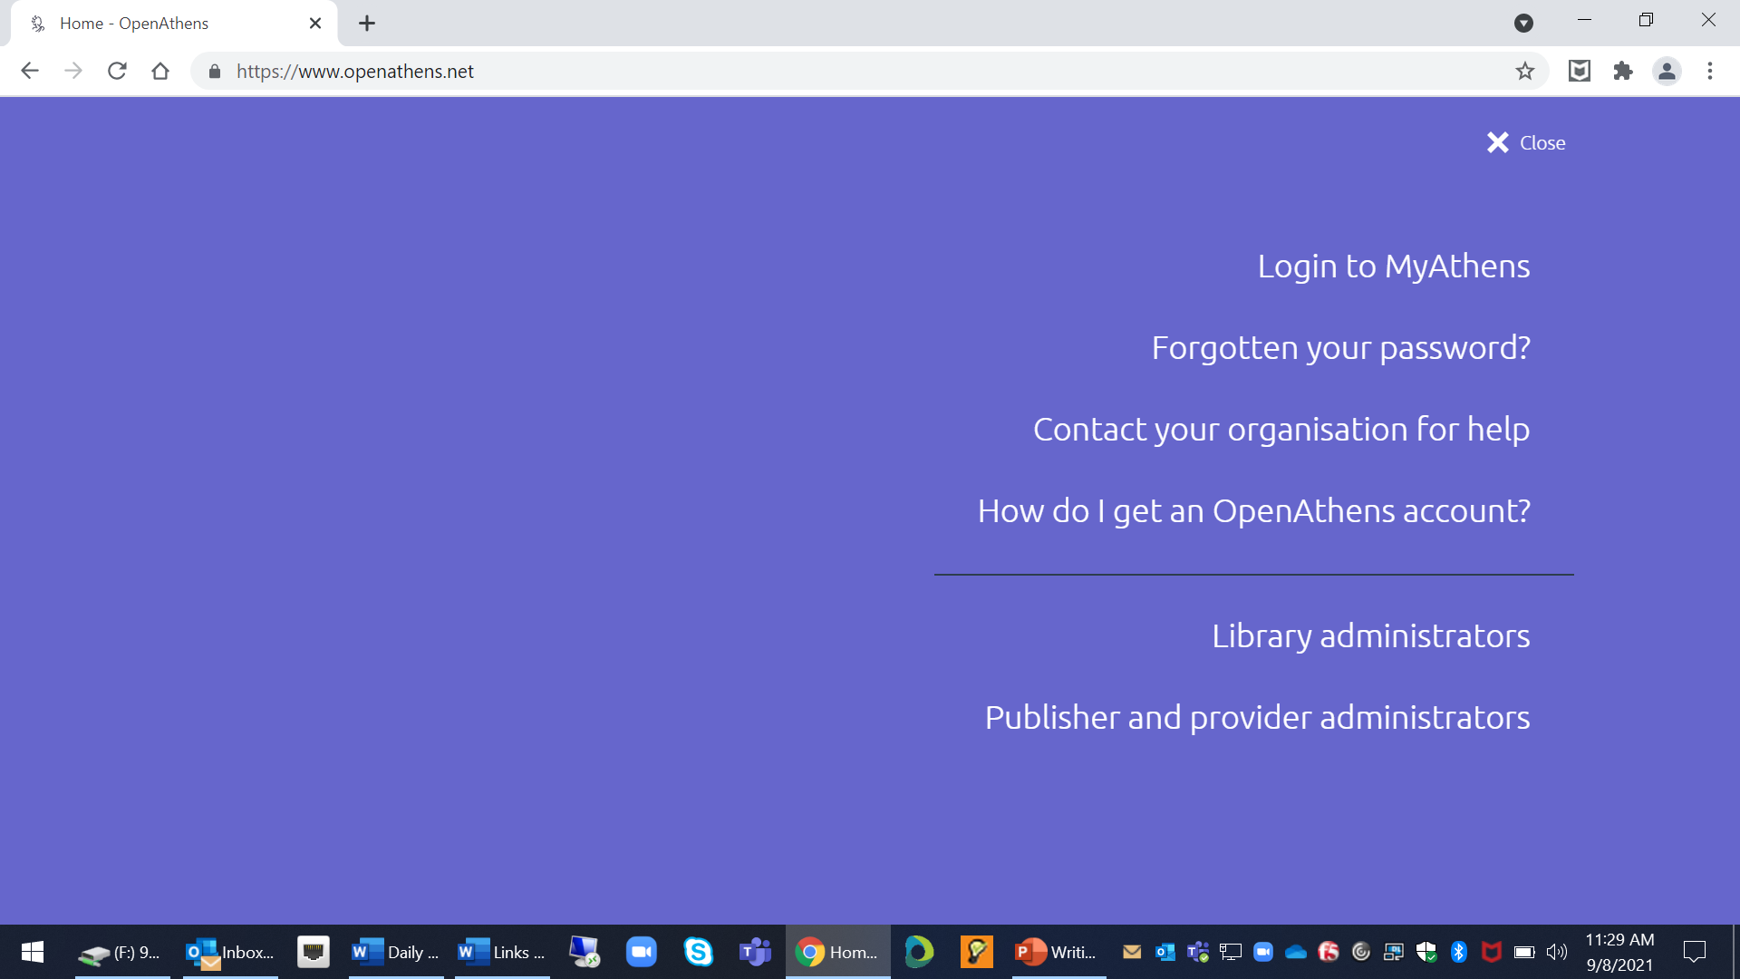

Slide 6
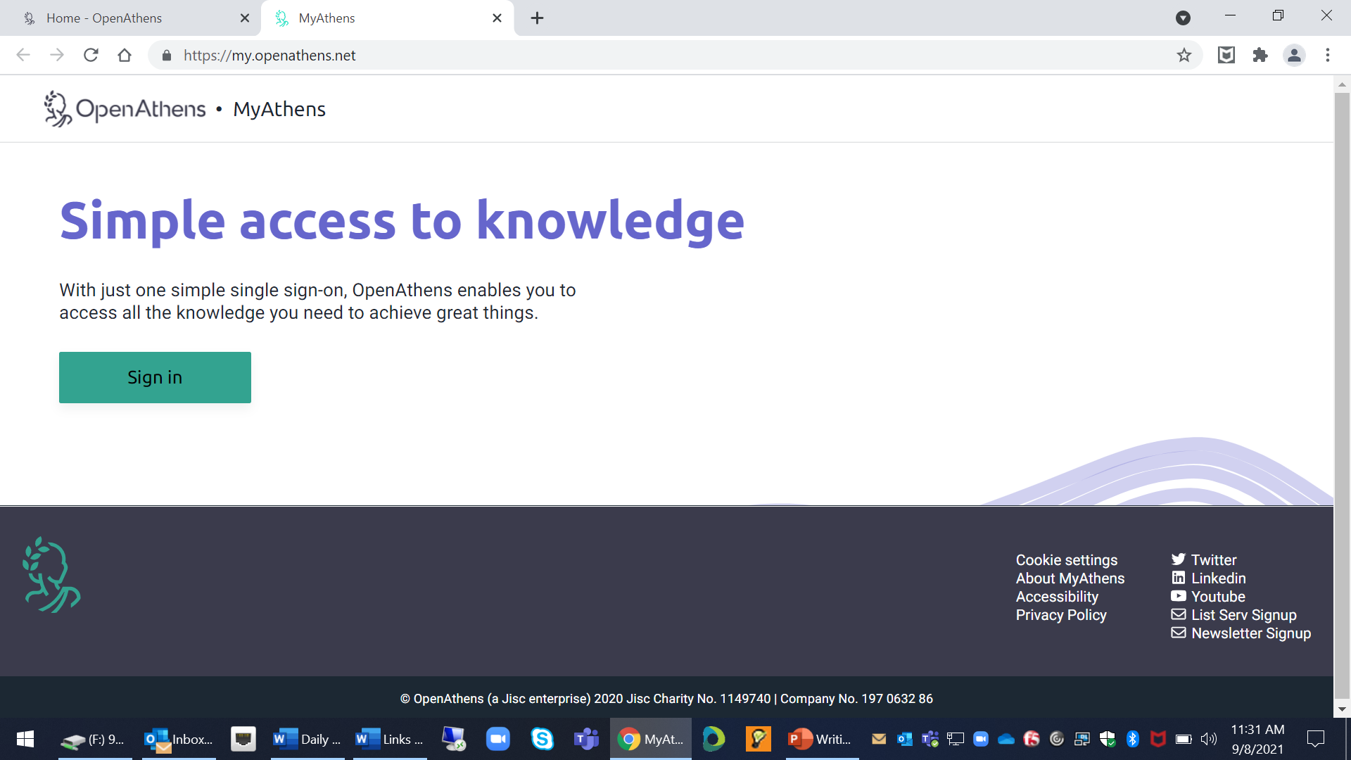

Slide 7
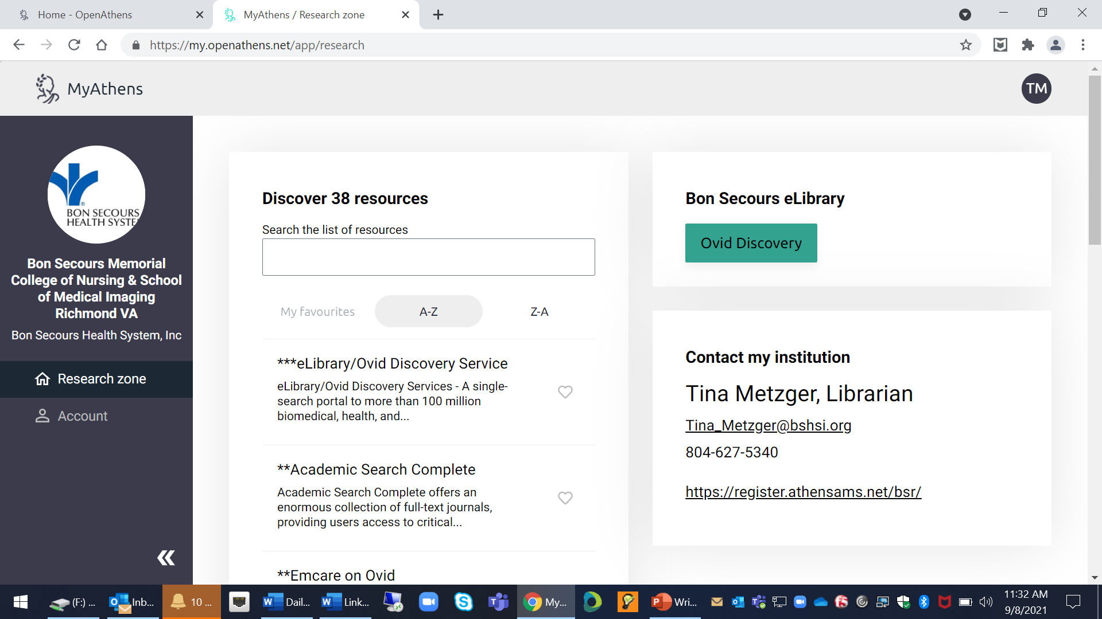

Slide 8
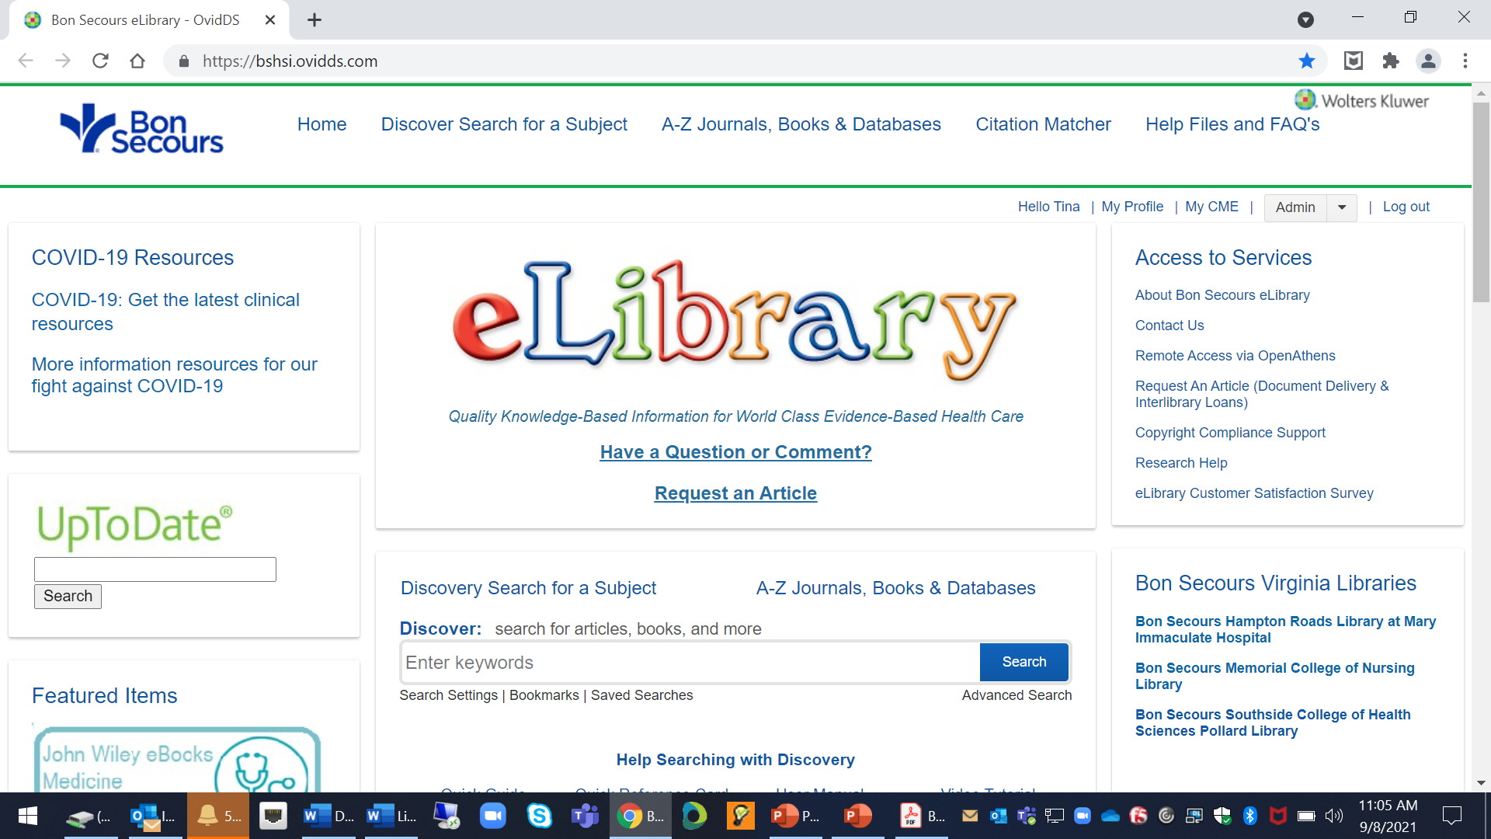
Doing the Research
How to Obtain Full Text
https://writingcenter.unc.edu/tips-and-tools/understanding-assignments/

Slide 9
How to limit your article search to peer-reviewed articles: Use the Advanced Search feature in Ovid Discovery

Slide 10
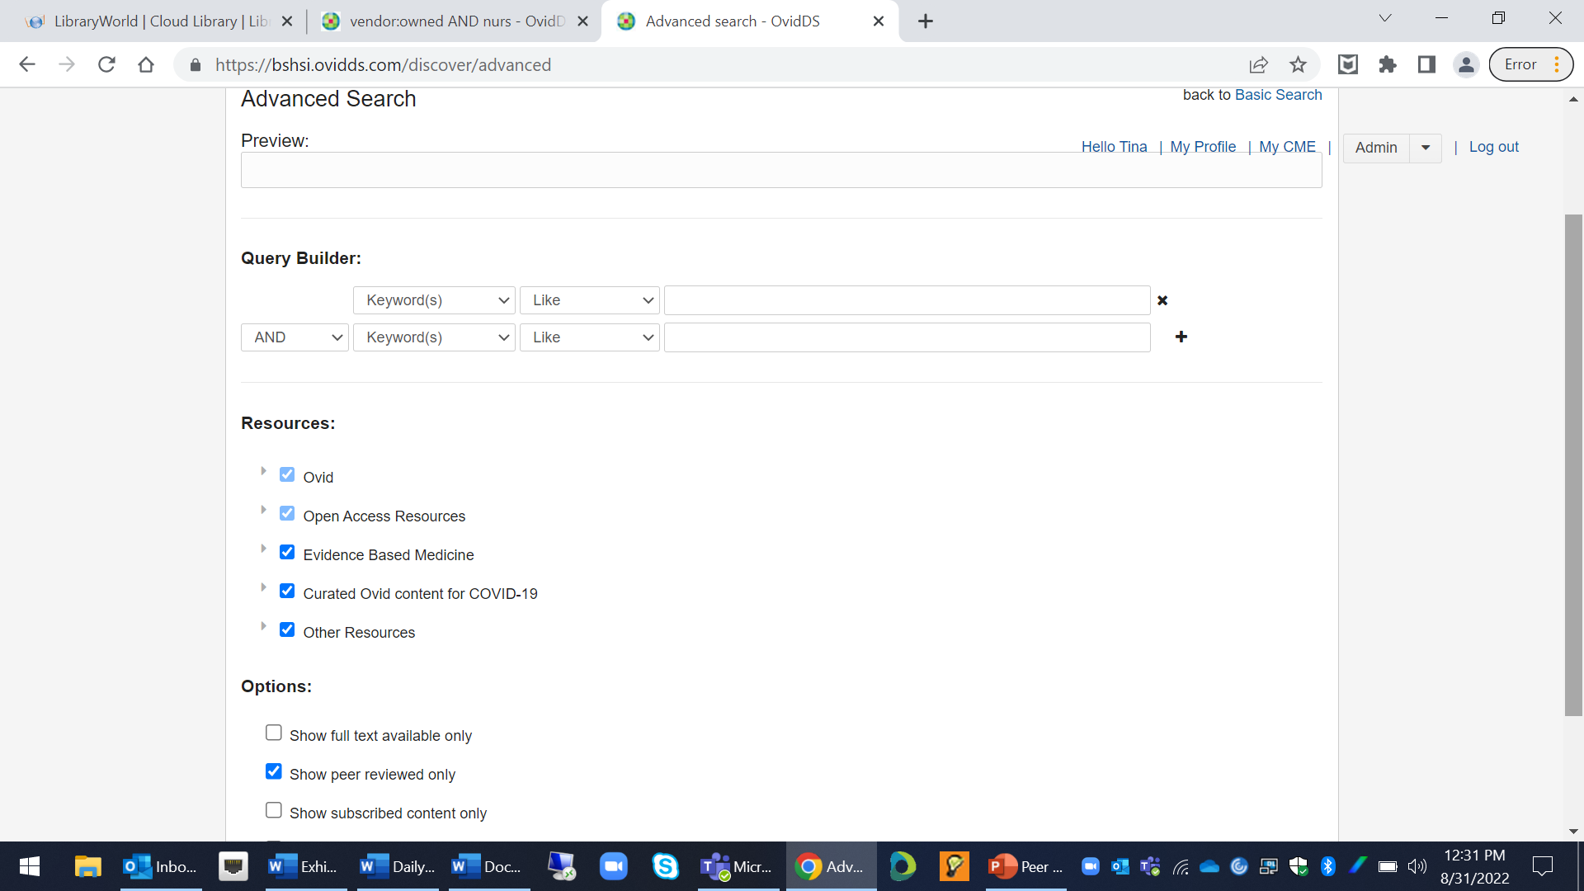
Click the Show Peer Reviewed Only Box Before Entering Your Search Terms

Slide 11
Use Scholarly Resources
University of Southern California: What is Scholarly v. Popular?
Purdue University OWL: Evaluating Sources of Information
Peer Review in 3 Minutes:
https://www.youtube.com/watch?v=rOCQZ7QnoN0
Bridgewater College: What are Peer-Reviewed Journals?
https://libguides.bridgewater.edu/c.php?g=945314

Slide 12
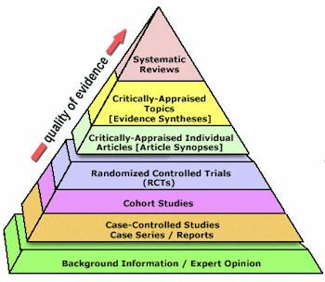
Evidence-Based Pyramid

Slide 13
Questions ?
Tina Metzger, Librarian
Monday-Friday 8 a.m. – 4:30 p.m.
library@bsmcon.edu
tina_metzger@bshsi.org
https://www.bsmcon.edu/library
(804) 627-5340

